Slide 1
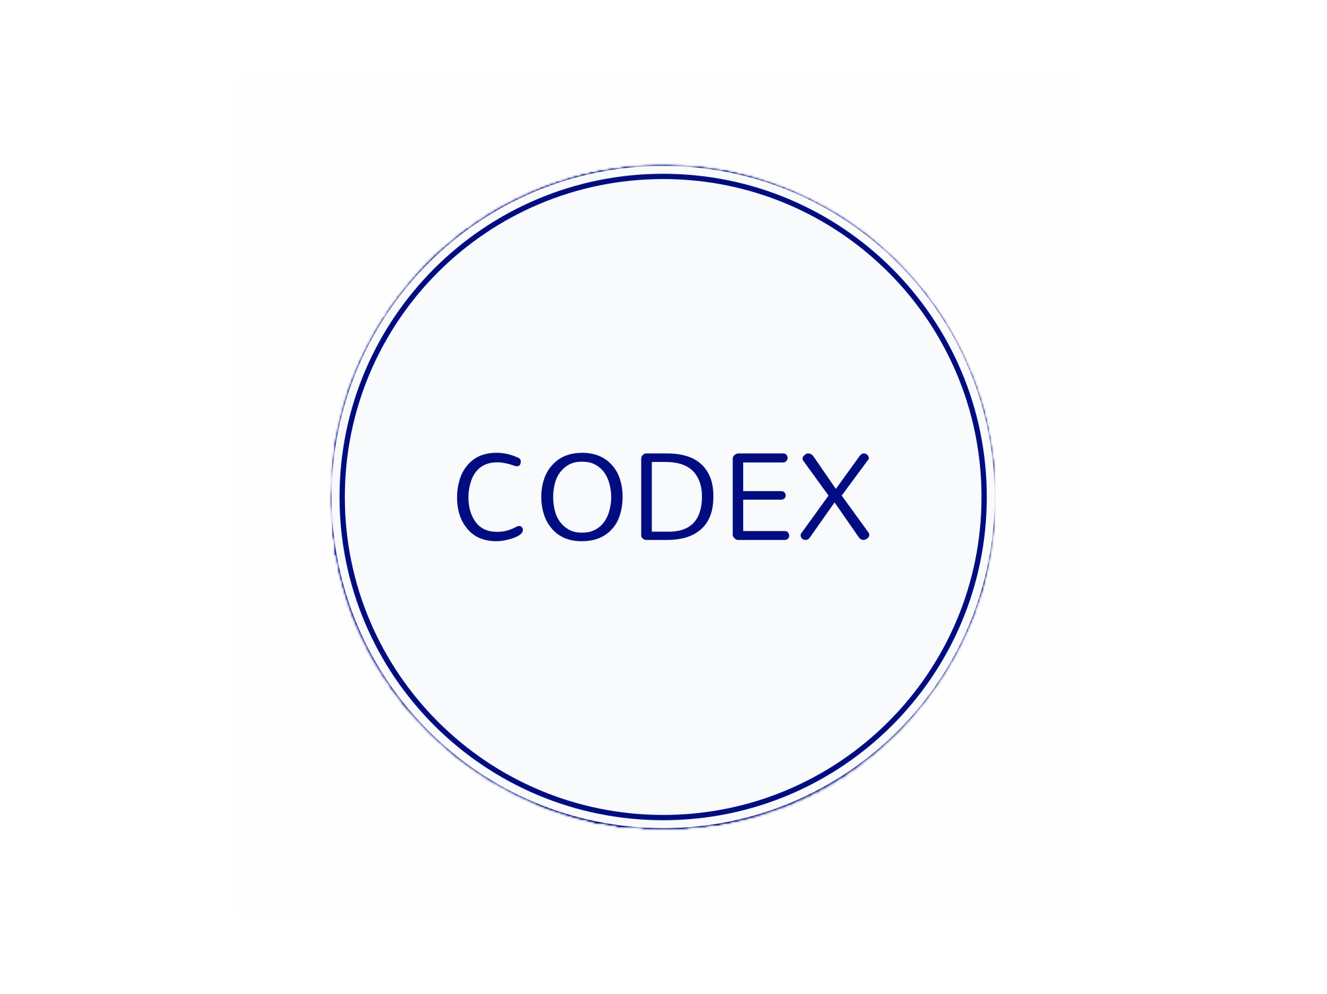

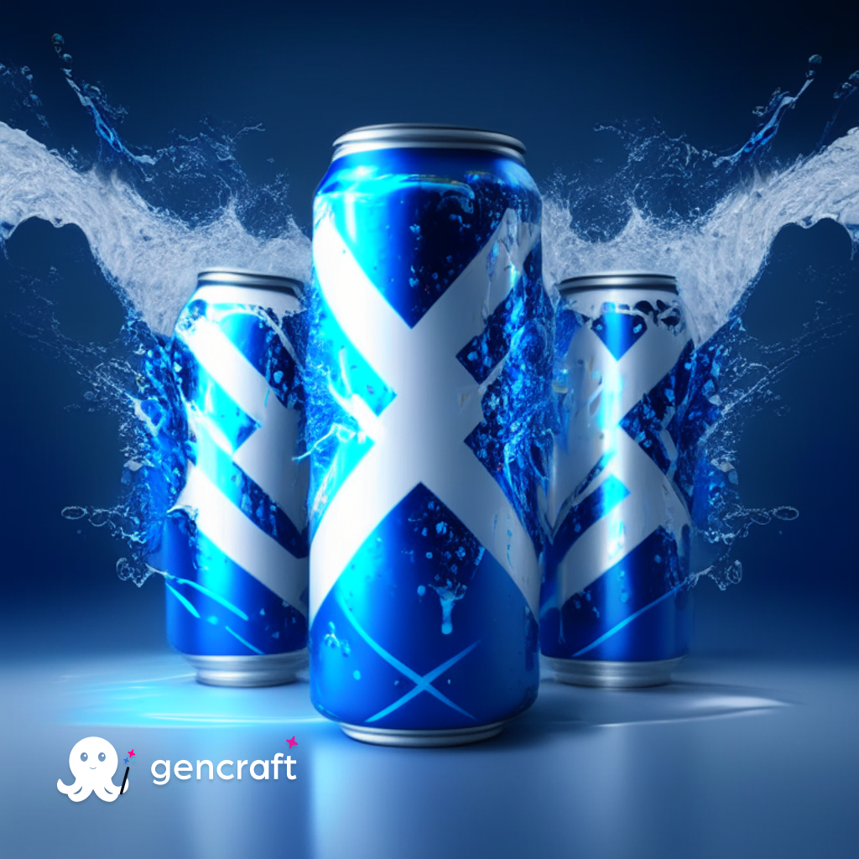
MARKETING INSIGHTS FOR FOOD AND BEVERAGE INDUSTRY
Presented by: Harshit Dubey (Data Analyst)

Slide 2
CONTENT
INTRODUCTION
METHODOLOGY OF SURVEY
PRIMARY INSIGHTS
SECONDARY INSIGHTS
CONCLUSION
RECOMMENDATION

Slide 3
INTODUCTION
CodeX, is a German Food and Beverage company .
CodeX recently launched their energy drink in 10 cities across India.
The Marketing team focused on increasing brand awareness, market share, and product development.
To gain valuable insights, a comprehensive survey was conducted among 10,000 respondents in these cities.
This presentation aims to provide a summary of the survey findings and recommendations on how CodeX can enhance its presence in the Indian market.

Slide 4
METHODOLOGY OF SURVEY
SURVEY DESIGN
SAMPLE SELECTION
DATA COLLECTION
DATA ANALYSIS
INSIGHTS EXTRACTION
REPORTING

Slide 5
PRIMARY INSIGHTS

Slide 6
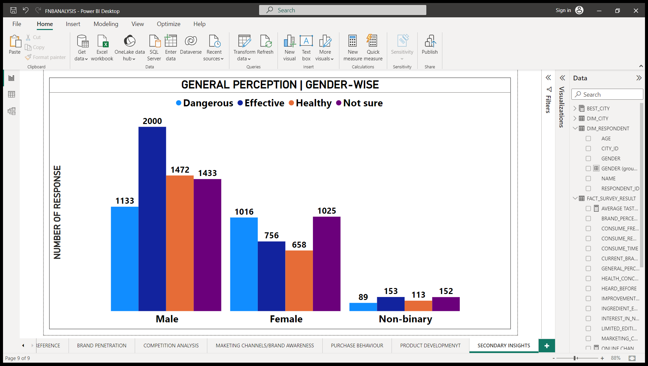
Demographic Insights
A) Who prefers energy drink more? (male/female/non-binary?)
HIGHLIGHTS : -
MALE : 6038 FEMALE : 3455 BINARY : 507
57.5% MALE AND 41% FEMALE PERCEIVE ENERGY DRINK AS EFFECTIVE AND HEALTHY.
19% MALE AND 29% FEMALE PERCEIVE ENERGY DRINK DANGEROUS.
INSIGHTS :- THERE ARE GENDER DIFFERENCES IN THE PERCEPTION OF ENERGY DRINKS. MALES TEND TO HAVE A MORE POSITIVE PERCEPTION OF ENERGY DRINKS, PERCEIVING THEM AS EFFECTIVE AND HEALTHY TO A GREATER EXTENT COMPARED TO FEMALES. FEMALES, ON THE OTHER HAND, ARE MORE LIKELY TO PERCEIVE ENERGY DRINKS AS POTENTIALLY DANGEROUS.

Slide 7
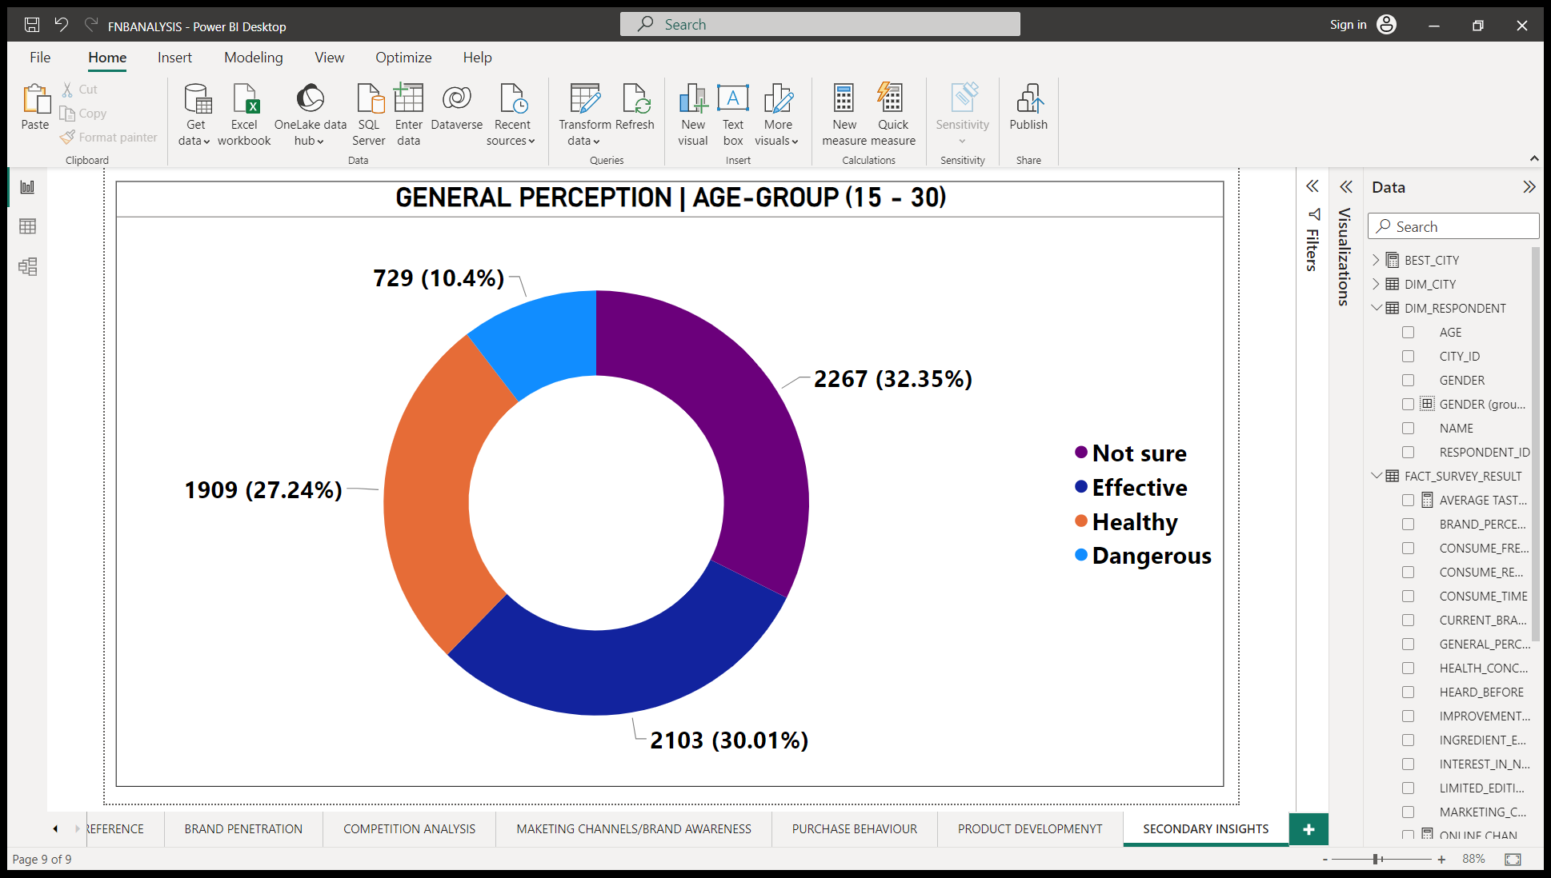
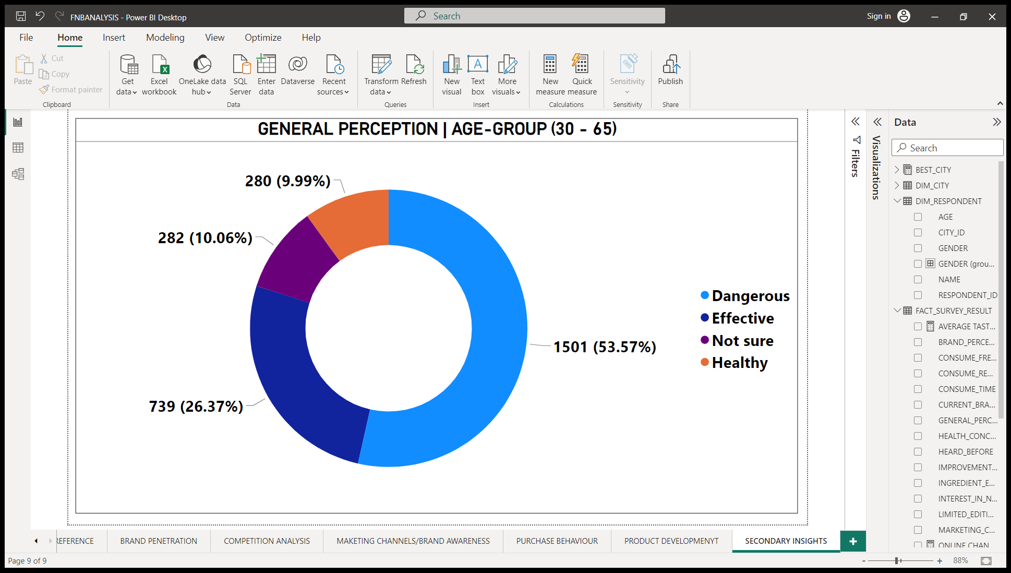
B) Which age group prefers energy drinks more?
HIGHLIGHTS : -
AGE GROUP : (15 – 18) - 1488, (19 – 30) - 5520, (31 – 45) - 2376,(45 – 65) - 426, 65+ - 190
AMONG 15 – 30 AGE GROUP, GENERAL PERCEPTION ABOUT DRINK IS 30% EFFECTIVE,27% HEALTHY AND ONLY 10% DANGEROUS.
WHERE AS AMONG 30 – 65 , 54% SAYS DANGEROUS AND ONLY 10% SAYS HEALTHY AND EFFECTIVE.
INSIGHTS :-
THERE IS A CHANGE IN PERCEPTION REGARDING THE EFFECTS AND HEALTH IMPLICATIONS OF DRINKS AS INDIVIDUALS GROW OLDER. YOUNGER INDIVIDUALS MAY HAVE A MORE POSITIVE AND OPTIMISTIC PERCEPTION, WHILE OLDER INDIVIDUALS TEND TO VIEW DRINKS WITH MORE CAUTION AND POTENTIAL RISKS.
ADDRESSING THE CONCERNS AND PREFERENCES OF DIFFERENT AGE GROUPS, ENSURING EFFECTIVE COMMUNICATION AND MEETING CAN ACHIEVE THE EXPECTATIONS OF THEIR TARGET CONSUMERS.

Slide 8
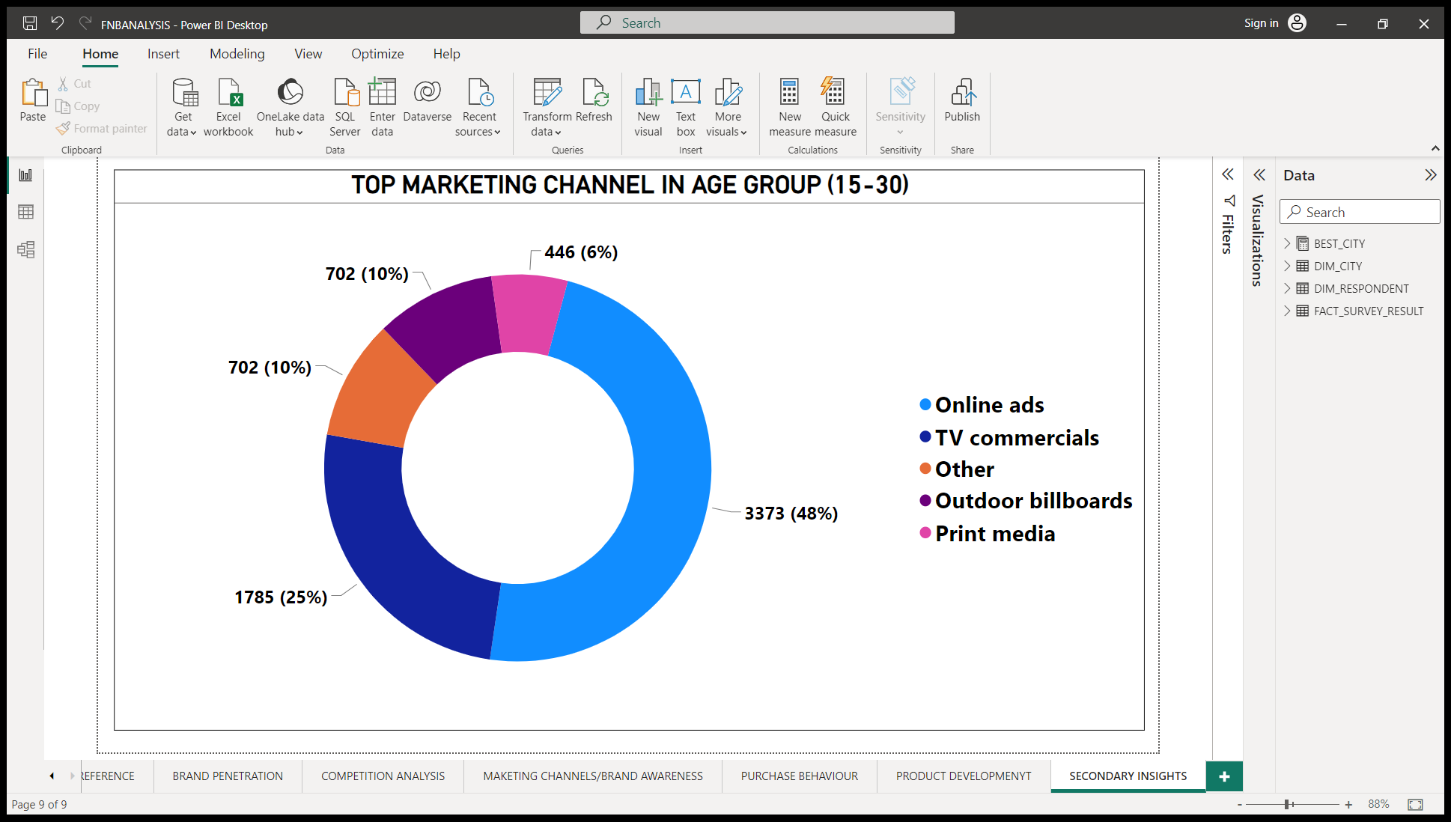
C) Which type of marketing reaches the most Youth (15-30)?
HIGHLIGHTS : -
AMONG AGE GROUP OF (15 – 30),48% PREFERS ONLINE ADS AS MARKETING CHANNEL.
25% ALSO SAYS TV COMMERCIAL BUT ONLY 6% SAYS PRINT MEDIA.
INSIGHTS :-
DIGITAL ADVERTISING PLATFORMS, SUCH AS SOCIAL MEDIA, WEBSITES, AND ONLINE VIDEO PLATFORMS, ARE HIGHLY EFFECTIVE IN REACHING AND ENGAGING WITH THE YOUNGER DEMOGRAPHIC.
A DECLINE IN THE EFFECTIVENESS OF PRINT MEDIA, SUCH AS NEWSPAPERS AND MAGAZINES, AMONG THE YOUNGER GENERATION. IT INDICATES THAT TRADITIONAL PRINT ADVERTISING MAY NOT BE AS INFLUENTIAL IN CAPTURING THE ATTENTION AND INTERESTS.

Slide 9
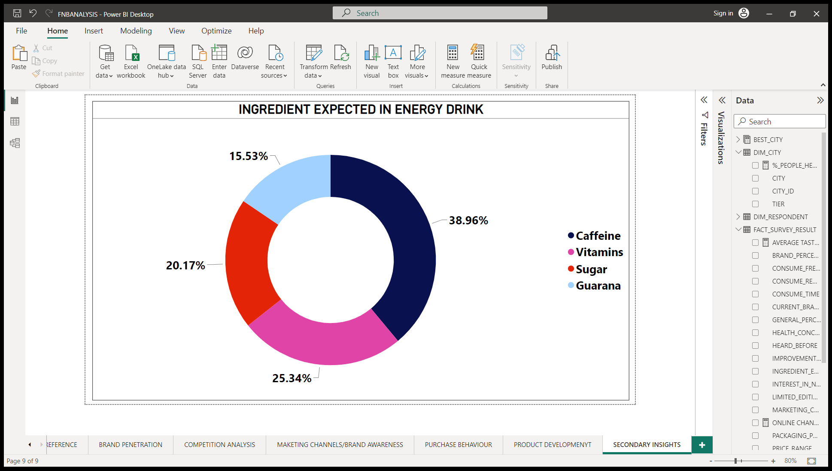
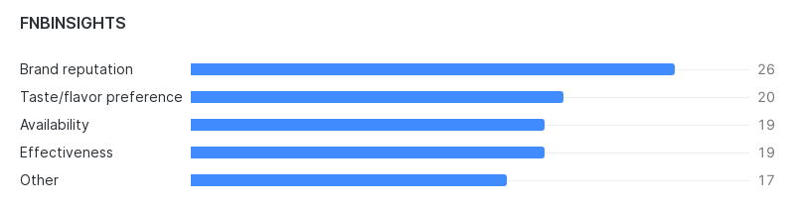
CONSUMER PREFERENCE
A) What are the preferred ingredients of energy drinks among respondents?
HIGHLIGHTS : -
MOST EXPECTED INGREDIENT IS CAFFEINE WITH 39% RESPONSE.
VITAMINS 25% AND SUGAR ONLY 20%.
INSIGHTS :-
CONSUMERS HAVE A STRONG ASSOCIATION BETWEEN ENERGY DRINKS AND THE PRESENCE OF CAFFEINE. CAFFEINE IS COMMONLY KNOWN FOR ITS STIMULANT EFFECTS, AND ITS INCLUSION IN ENERGY DRINKS ALIGNS WITH THE EXPECTED FUNCTION OF PROVIDING AN ENERGY BOOST.
CONSUMERS HAVE A MODERATE PREFERENCE FOR THE INCLUSION OF VITAMINS IN THEIR ENERGY DRINKS, POSSIBLY INDICATING A DESIRE FOR ADDED NUTRITIONAL BENEFITS. ON THE OTHER HAND, THE RELATIVELY LOWER PREFERENCE FOR SUGAR SUGGESTS THAT CONSUMERS MAY BE CONSCIOUS OF THE SUGAR CONTENT IN THEIR BEVERAGES AND MAY PREFER ENERGY DRINKS WITH LOWER SUGAR LEVELS.
REASON FOR CHOOSING OTHER BRAND WHEN INGREDIENT IS SUGAR

Slide 10
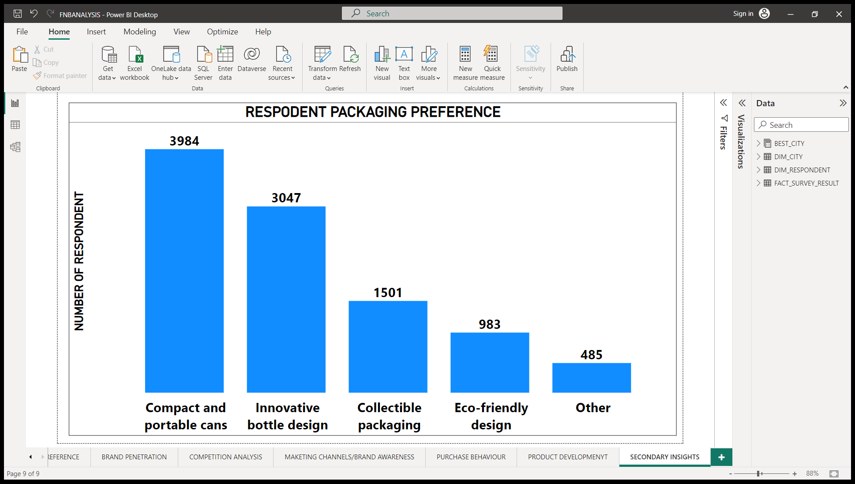
B) What packaging preferences do respondents have for energy drinks?
HIGHLIGHTS : -
40% RESPONDENT PREFERS COMPACT AND PORTABLE CANS AND 30% PREFERS INNOVATIVE BOTTLE DESIGN.
ONLY 10% PREFERS ECO-FRIENDLY DESIGN.
INSIGHTS :-
MARKET VALUES THE ABILITY TO CARRY THEIR BEVERAGE EASILY,POTENTIALLY INDICATING A PREFERENCE FOR ON-THE-GO CONSUMPTION.
WHILE ENVIRONMENT CONSCIOUS IS GAINING IMPORTANCE IN SOCIETY,IT MAY NOT YET BE A SIGNIFICANT FACTOR IN THE PURCHASING DECISIONS.

Slide 11
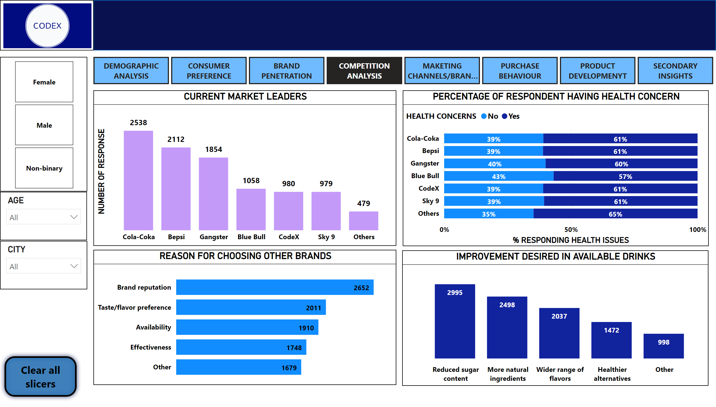
COMPETITION ANALYSIS
A) Who are the current market leaders?
HIGHLIGHTS : -
COLA-COKA IS MARKET LEADER WITH 25% OF MARKET SHARE.
BEPSI IS SECOND LARGEST WITH 21% SHARE AND GANGSTER WITH 19% SHARE OF MARKET.
OUR COMPANY CODEX HAS 10% MARKET SHARE.
INSIGHTS :-
THE CARBONATED BEVERAGE INDUSTRY IS CHARACTERIZED BY INTENSE COMPETITION, WHERE EACH COMPANY MUST CONTINUOUSLY INNOVATE AND DIFFERENTIATE ITSELF TO ATTRACT AND RETAIN CUSTOMERS. IT ALSO INDICATES THAT SMALLER PLAYERS LIKE CODEX, WITH A 10% MARKET SHARE, FACE A CHALLENGING ENVIRONMENT AND NEED TO DEVELOP EFFECTIVE STRATEGIES .

Slide 12
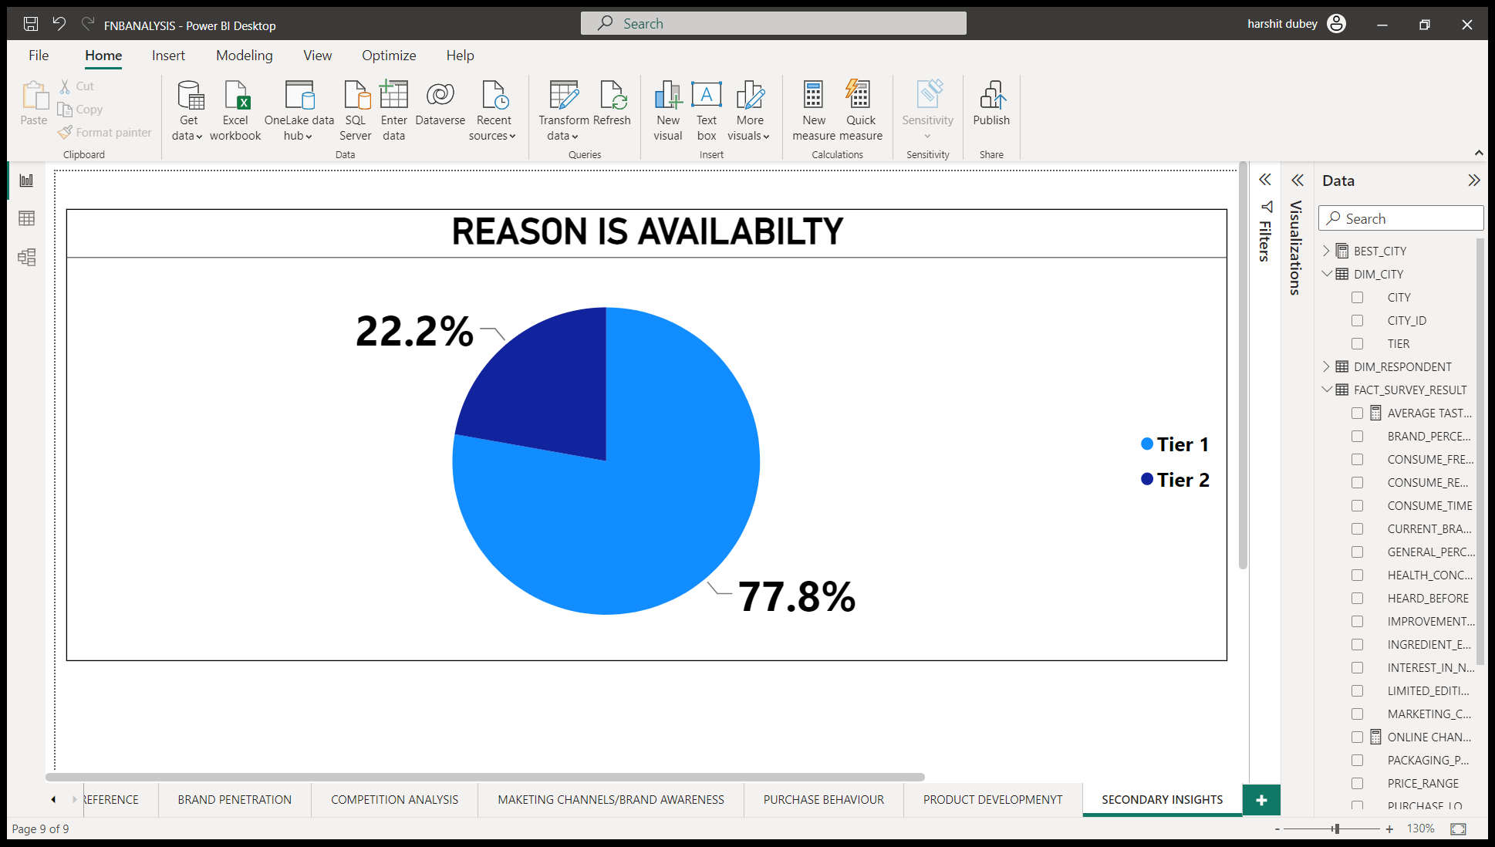
B) What are the primary reasons consumers prefer those brands over ours?
HIGHLIGHTS : -
AROUND 26.5% PEOPLE CHOOSE OTHER BRANDS BECAUSE OF
BRAND REPUTATION.
AROUND 20% CHOOSE FOR TASTE WHICH EVERY 1 IN 5 RESPONDENT.
AVAILABILITY 19% AND EFFECTIVENESS 17% IS REASON FOR CHOOSING OTHER BRANDS.
78% WHO SAYS AVAILABILITY IS ISSUE ARE FROM TIER-1 CITIES.
INSIGHTS :-
THE IMPORTANCE OF BRAND PERCEPTION AND REPUTATION IN THE DECISION-MAKING PROCESS OF CONSUMERS.
THE ISSUE OF AVAILABILITY IS PARTICULARLY PROMINENT IN URBAN AREAS WITH HIGHER POPULATION DENSITIES AND GREATER CONSUMER DEMAND.

Slide 13
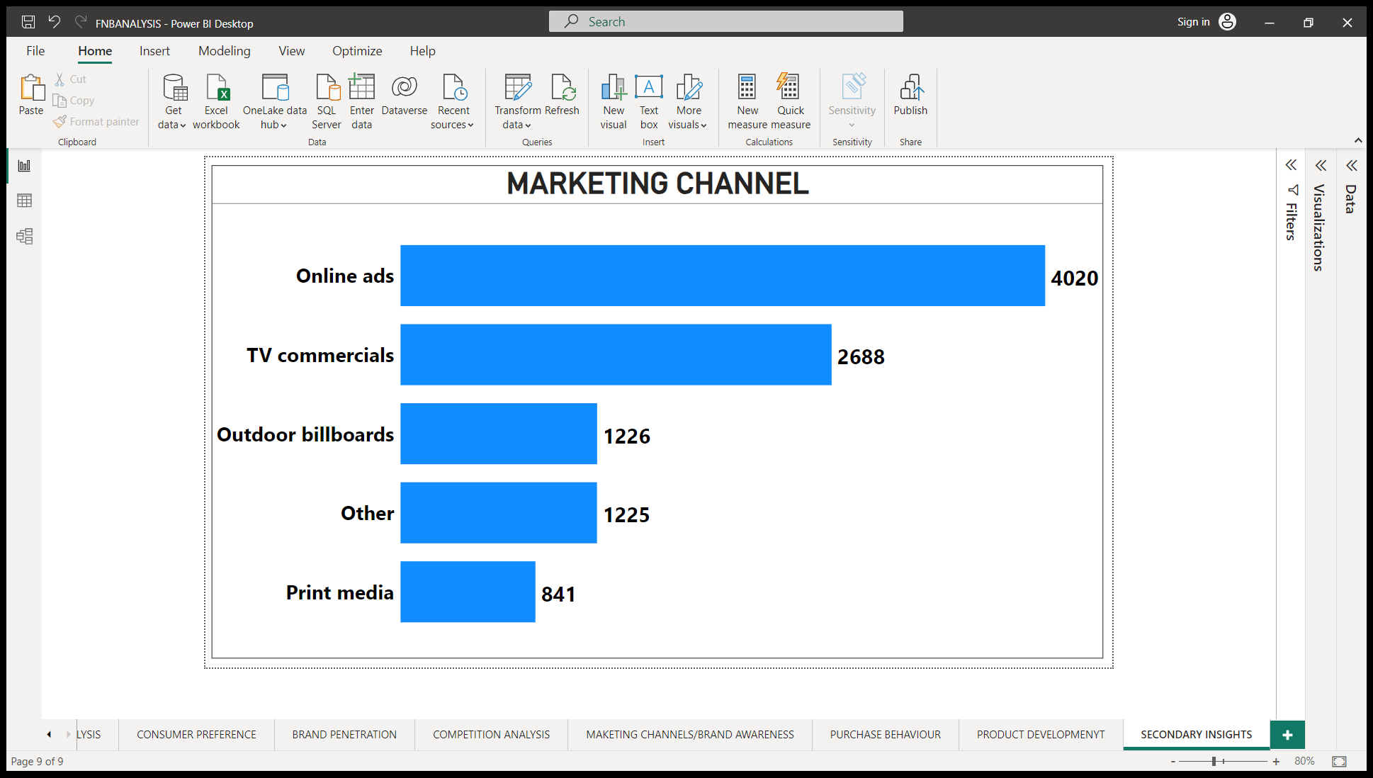
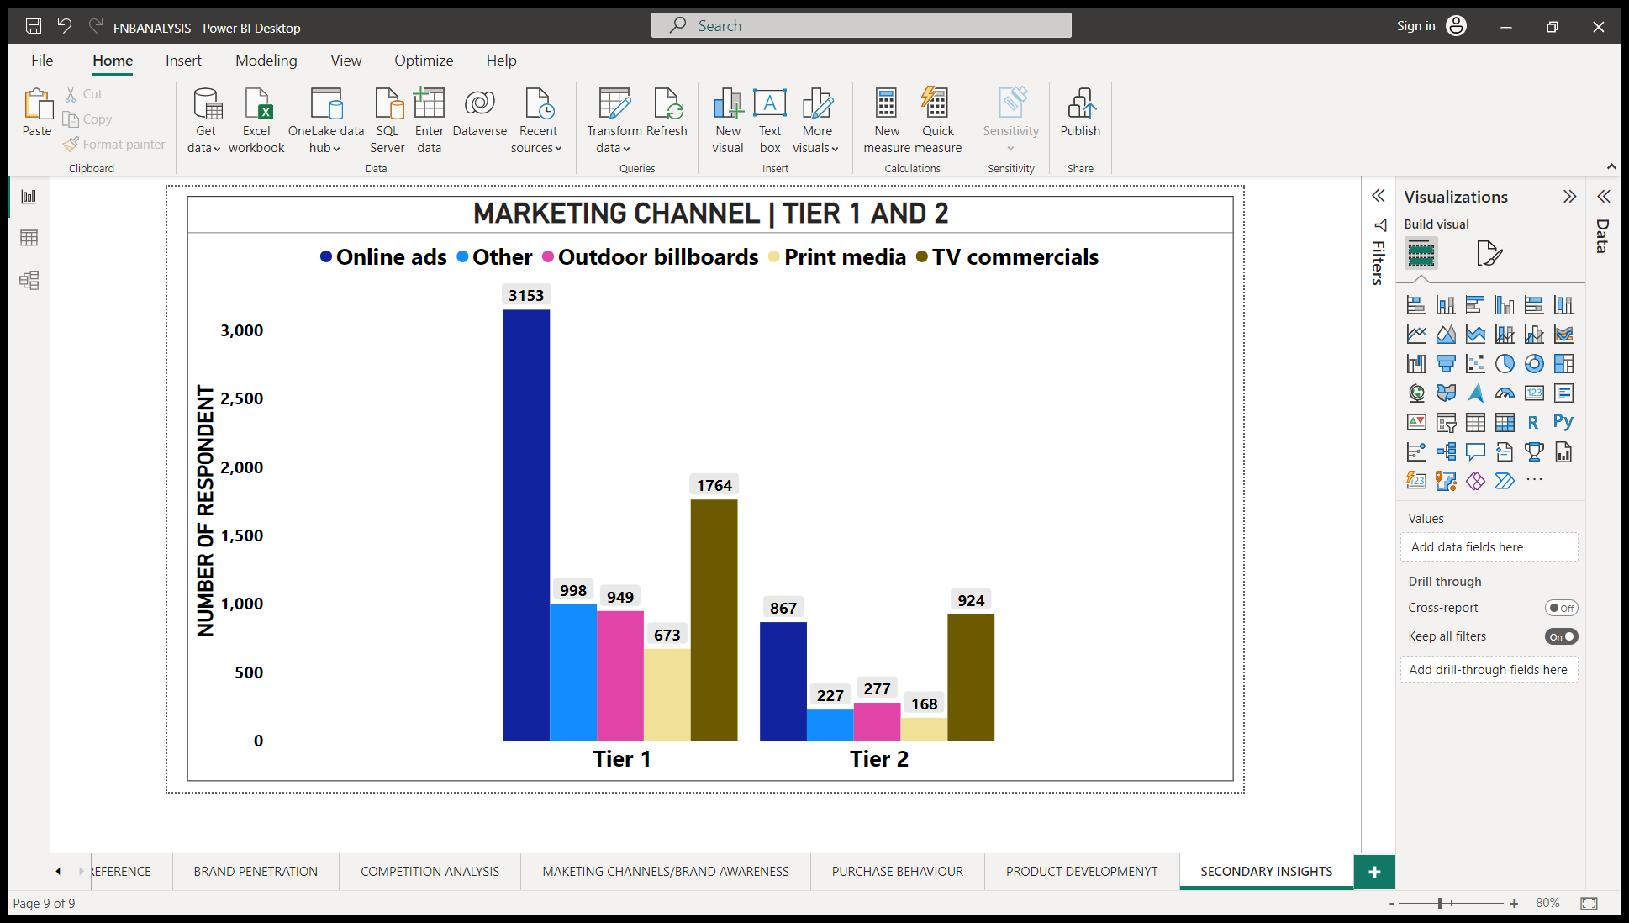
Marketing Channels and Brand Awareness
A) Which marketing channel can be used to reach more customers?
HIGHLIGHTS : -
ONLINE ADS ARE MOST USED MARKETING CHANNEL WITH 40% .
PRINT MEDIA IS LEAST EFFECTIVE MARKETING CHANNEL WITH ONLY 8.5%.
TV COMMERCIAL IS TOP MARKETING CHANNEL IN TIER-2 CITIES.
INSIGHTS :-
ONLINE ADS (40%) DEMONSTRATE THE GROWING SIGNIFICANCE OF DIGITAL MARKETING STRATEGIES FOR BRAND PROMOTION AND ENGAGEMENT.
PRINT MEDIA (8.5%) SHOWS LIMITED IMPACT, SUGGESTING THE NEED TO RECONSIDER ITS EFFECTIVENESS AND EXPLORE ALTERNATIVE MARKETING CHANNELS.
TV COMMERCIALS DOMINATE IN TIER-2 CITIES, INDICATING THEIR CONTINUED EFFECTIVENESS IN CAPTURING THE ATTENTION OF AUDIENCES IN THESE REGIONS.

Slide 14
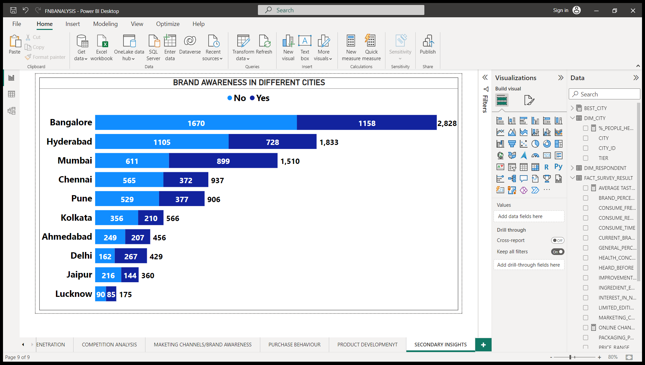
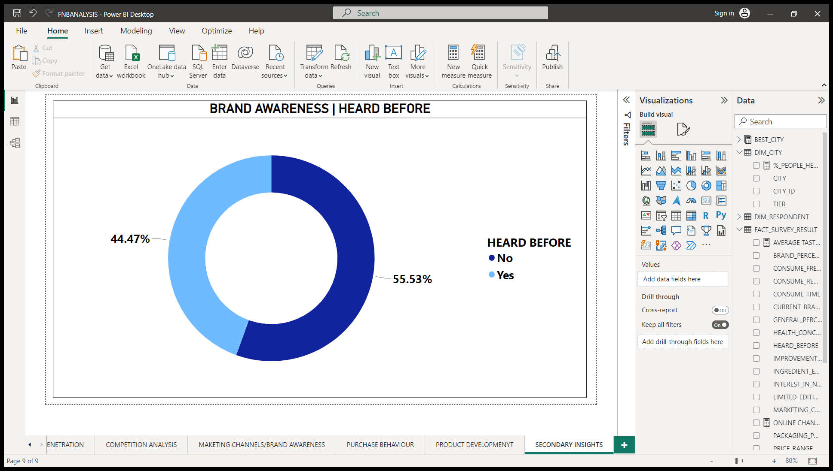
B) How effective are different marketing strategies and channels in reaching our customers?
HIGHLIGHTS : -
ONLY 44.47% SAY THEY HAVE HEARD OUR BRAND BEFORE.
MUMBAI AND DELHI ARE ONLY TWO CITIES WHERE MORE THEN 50% RESPONDENT SAYS “YES”.
63% RESPONDENT SAYS “NO” IN KOLKATA i.e. THEY HAVE NEVER HEARD OUR BRAND BEFORE.
INSIGHTS :- THE NEED FOR TARGETED MARKETING AND PROMOTIONAL STRATEGIES TAILORED TO SPECIFIC CITIES OR REGIONS TO IMPROVE BRAND AWARENESS.
THE IMPORTANCE OF INVESTING RESOURCES IN CREATING BRAND AWARENESS CAMPAIGNS AND TARGETED MARKETING ACTIVITIES SPECIFICALLY IN KOLKATA TO TAP INTO THIS POTENTIAL MARKET.

Slide 15
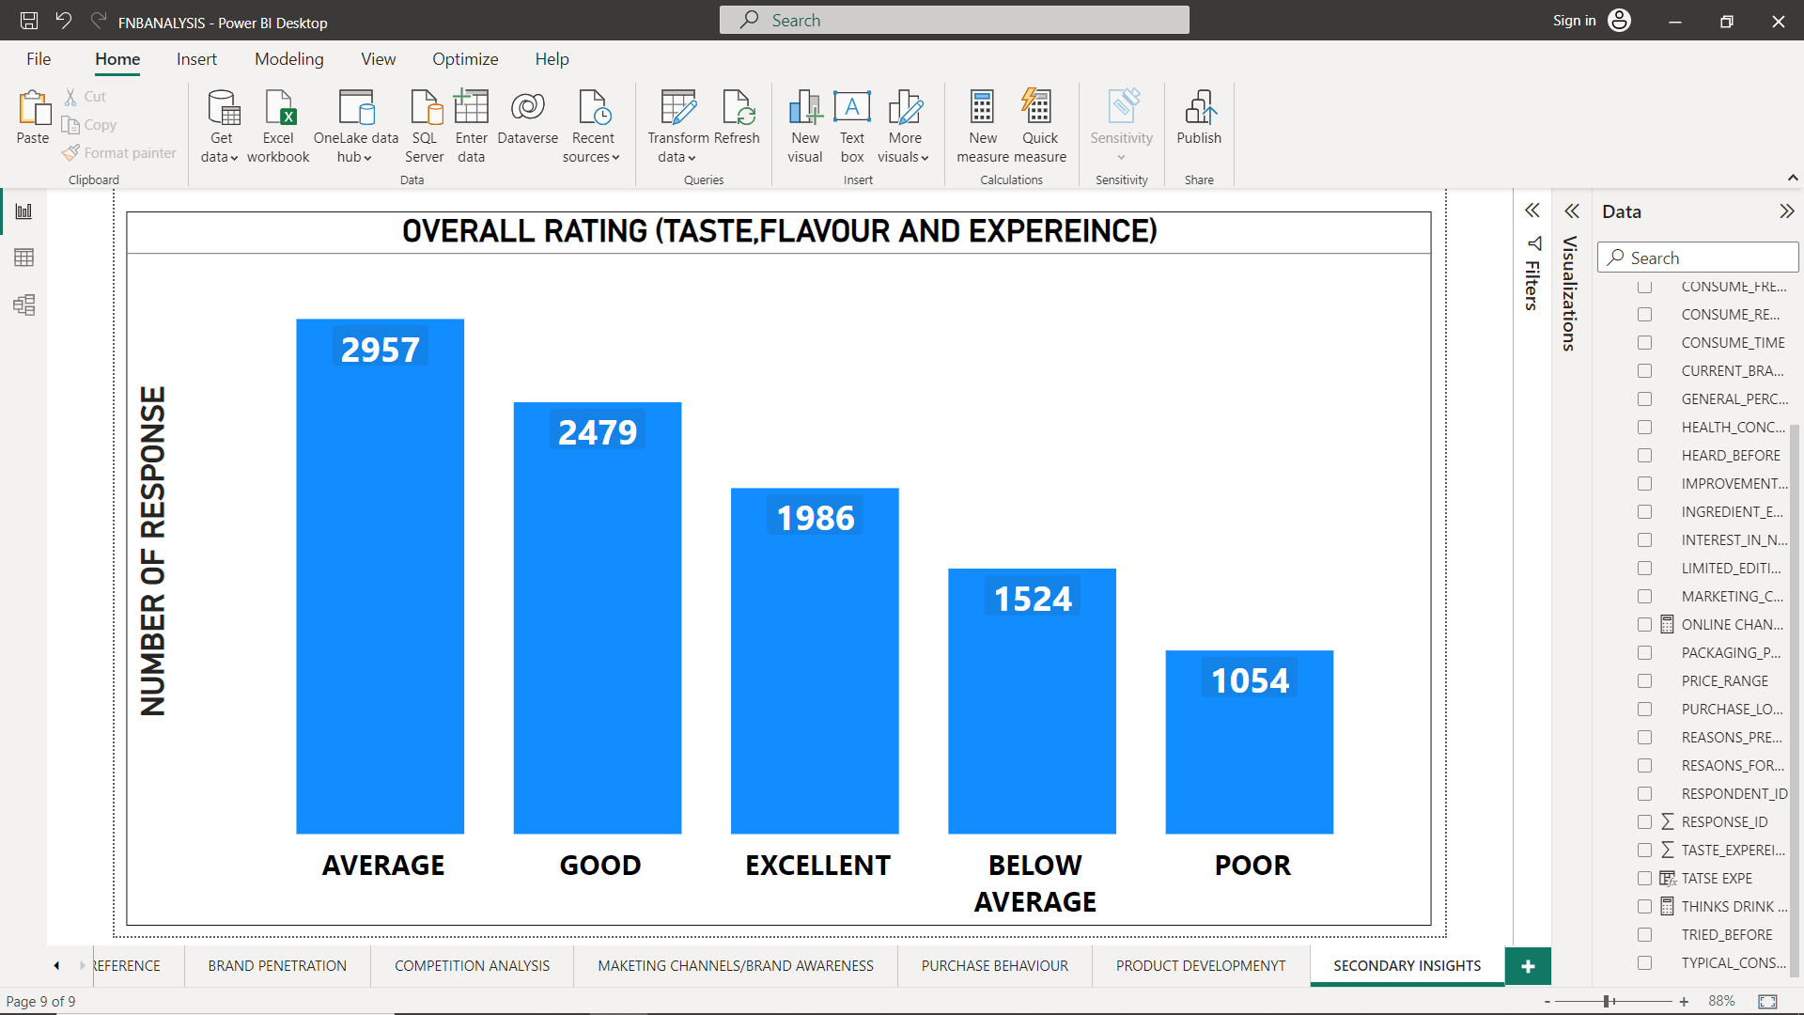
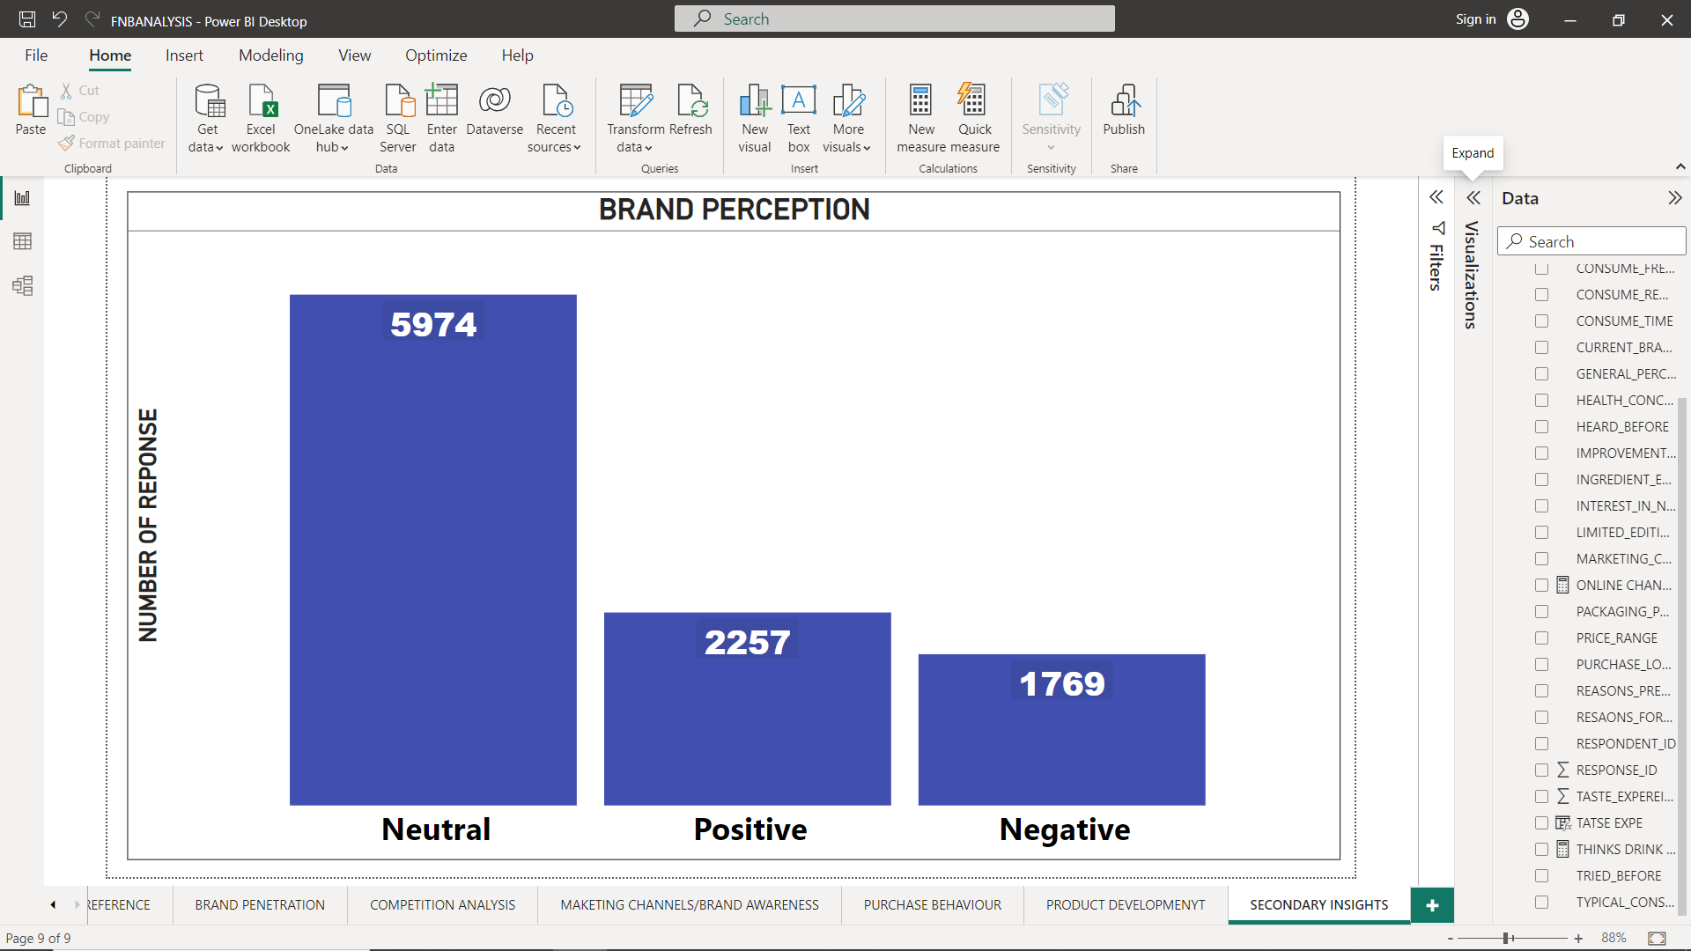
Brand Penetration
A) What do people think about our brand? (overall rating)
HIGHLIGHTS : -
75% SAYS OUR BRAND IS AVERAGE OR ABOVE AVERAGE.
60% OF RESPONDENT HAVE NEUTRAL BRAND PERCEPTION AND ONLY 22.5 % HAVE POSITIVE PERCEPTION.
26% SAYS OUR BRAND IS BELOW AVERAGE OR POOR.
ONLY 20% SAYS WE HAVE EXCELLENT BRAND.
INSIGHTS :-
BRAND PERCEPTION IS MIXED : THERE IS ROOM FOR IMPROVEMENT IN SHAPING A MORE FAVORABLE BRAND IMAGE AND ENHANCING OVERALL BRAND PERCEPTION.
INVESTING IN STRATEGIES THAT EMPHASIZE BRAND DIFFERENTIATION, QUALITY IMPROVEMENT, CUSTOMER ENGAGEMENT, AND DELIVERING EXCEPTIONAL EXPERIENCES CAN HELP ELEVATE THE BRAND'S POSITION AND FOSTER STRONGER CUSTOMER ADVOCACY.

Slide 16
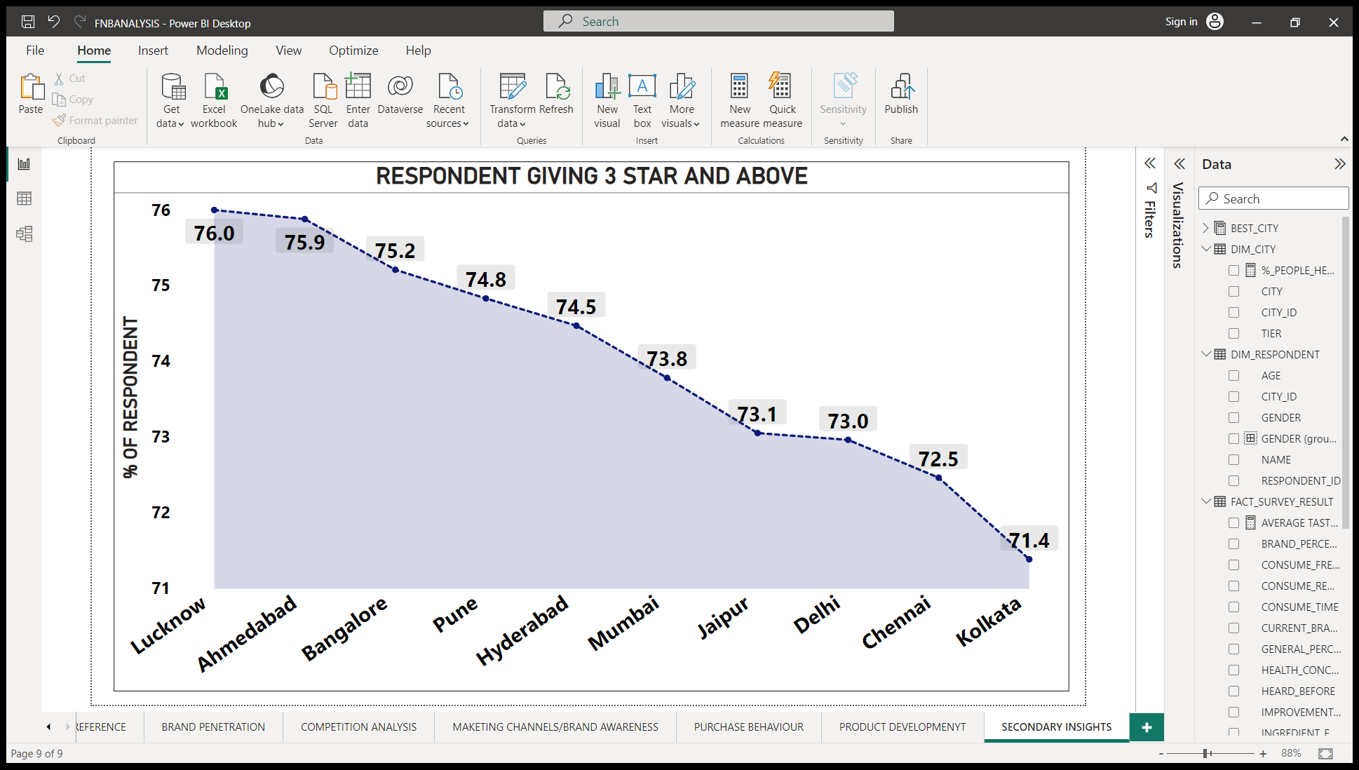
B) Which cities do we need to focus more on?
HIGHLIGHTS : -
LUCKNOW HAVE MOST 76% GIVING 3 STAR OR MORE.
KOLKATA AND CHENNAI HAVE ONLY 72% GIVING 3 STAR OR ABOVE.
INSIGHTS :- VARYING CUSTOMER SATISFACTION LEVELS: THERE MAY BE VARIATIONS IN CUSTOMER SATISFACTION LEVELS ACROSS DIFFERENT CITIES. UNDERSTANDING THE FACTORS CONTRIBUTING TO HIGHER SATISFACTION LEVELS IN LUCKNOW AND ADDRESSING ANY POTENTIAL ISSUES IN KOLKATA AND CHENNAI CAN HELP IMPROVE OVERALL CUSTOMER SATISFACTION.

Slide 17
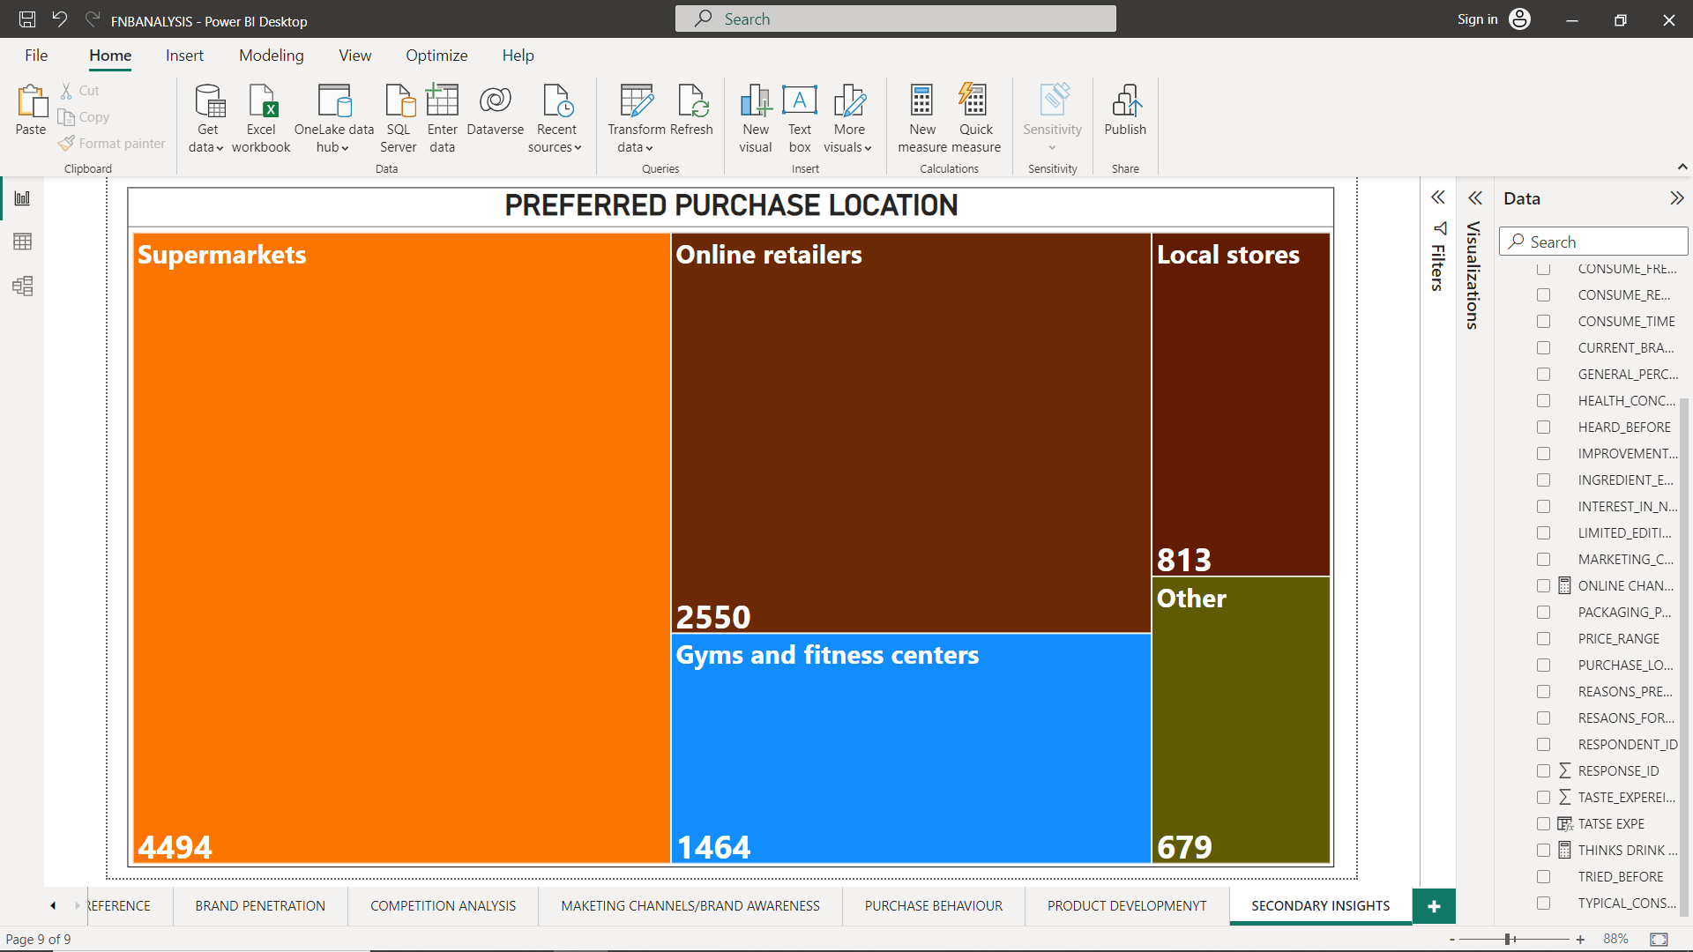
Purchase Behaviour
A) Where do respondents prefer to purchase energy drinks?
HIGHLIGHTS : -
45% PURCHASE DRINK FROM SUPERMARKETS AND 25% FROM ONLINE RETAILERS.
813 BUYS FROM LOCAL STORES AND 1464 BUYS AT GYM CENTERS.
INSIGHTS :-
BRANDS SHOULD ENSURE THEIR PRESENCE AND AVAILABILITY IN BOTH SUPERMARKET SHELVES AND ONLINE PLATFORMS.
A POTENTIAL SALES OPPORTUNITY FOR ENERGY DRINKS AT GYM CENTERS. PARTNERING WITH GYM CENTERS OR EXPLORING TARGETED MARKETING CAMPAIGNS WITHIN FITNESS FACILITIES CAN HELP CAPTURE THIS SPECIFIC MARKET.

Slide 18
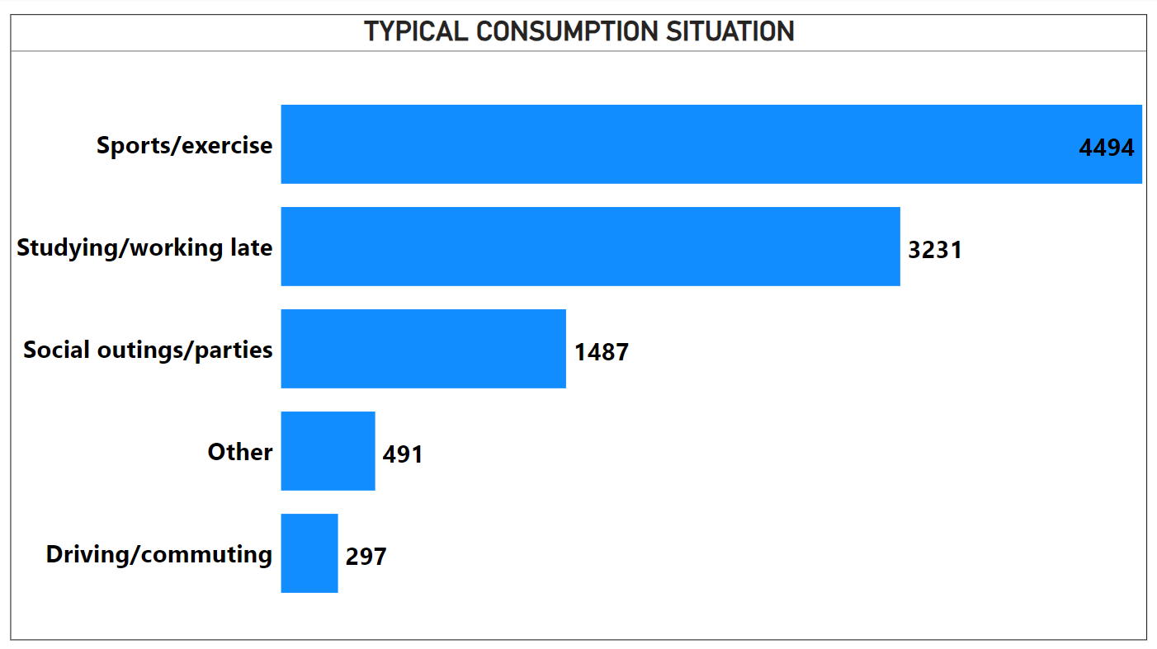
B) What are the typical consumption situations for energy drinks among respondents?
HIGHLIGHTS : -
45% CONSUME DRINK DURING SPORTS/EXERCISE AND 32% DURING STUDYING.
AT SOCIAL OUTING ONLY 15% CONSUME DRINK AND ONLY 3% CONSUME ENERGY DRINK DURING DRIVING.
INSIGHTS :-
TARGETING ACTIVE INDIVIDUALS AND POSITIONING THE ENERGY DRINKS AS A SOURCE OF FUEL AND PERFORMANCE ENHANCEMENT DURING WORKOUTS OR PHYSICAL ACTIVITIES CAN BE AN EFFECTIVE MARKETING STRATEGY.
PROMOTING THE BENEFITS OF ENERGY DRINKS IN SUPPORTING COGNITIVE PERFORMANCE AND IMPROVED FOCUS CAN RESONATE WITH THIS TARGET AUDIENCE.

Slide 19
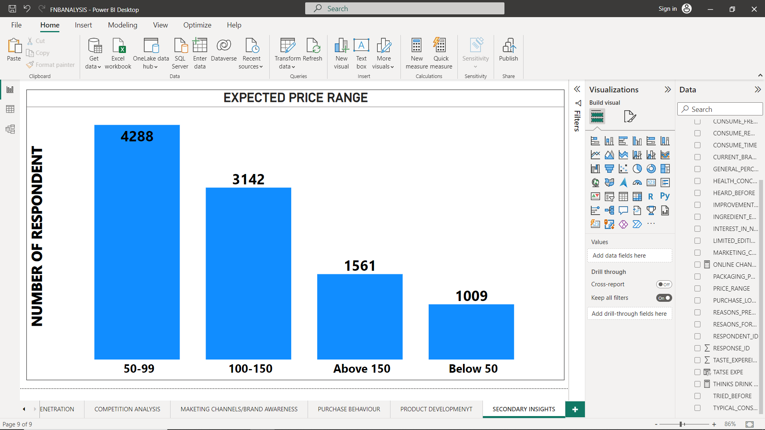
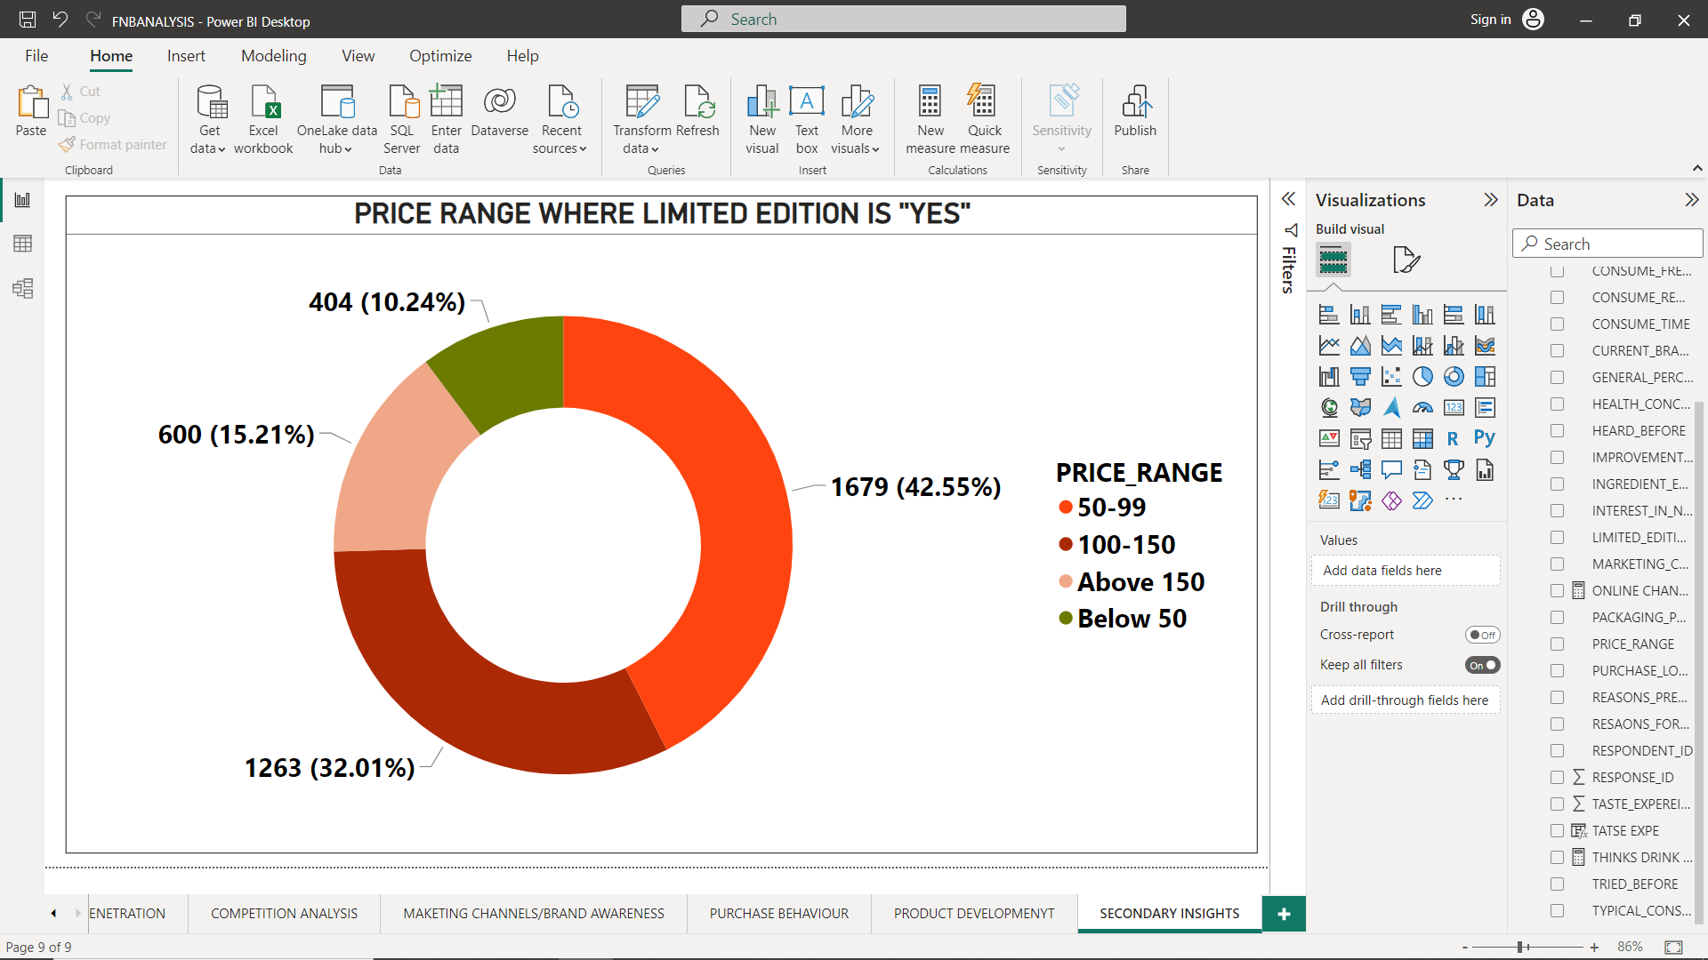
C) What factors influence respondent purchase decisions, such as price range and limited edition packaging?
HIGHLIGHTS : -
84% RESPONDENT PREFERS PRICE UNDER 150 AND ONLY 16% SAYS ABOVE 150 IS FINE.
THOSE WHO PREFERS LIMITED EDITION PACKAGING,85% PREFERS PRICE UNDER 150 AND 58% PREFERS PRICE UNDER 100.
INSIGHTS :-
THE SIGNIFICANCE OF PRICE SENSITIVITY IN THE ENERGY DRINK MARKET AND THE NEED TO ALIGN PRICING STRATEGIES WITH CONSUMER PREFERENCES.
ADDITIONALLY, IT EMPHASIZES THE POTENTIAL SYNERGY BETWEEN LIMITED EDITION PACKAGING AND AFFORDABLE PRICING TO ENHANCE CONSUMER INTEREST AND DRIVE PURCHASE DECISIONS.

Slide 20
Product Development
A) Which area of business should we focus more on our product development? (Branding/taste/availability)
Brand Reputation: Addressing brand reputation is crucial, as approximately 26.5% of people choose other brands due to brand reputation. Investing in strategies that enhance brand image, such as transparency, quality assurance, and effective communication, can help improve customer trust and loyalty.
Taste: The data reveals that around 20% of respondents choose a product based on taste. Therefore, focusing on continuously improving and refining the taste of the drink through taste tests, gathering consumer feedback, and making necessary adjustments can contribute to better customer satisfaction and increased market appeal.
Availability: Availability is another factor influencing consumer choices, with 19% of respondents citing it as a reason for choosing other brands. Ensuring widespread availability through robust distribution channels, efficient supply chain management, and partnerships with supermarkets and online retailers can help capture and retain customers.

Slide 21
SECONDARY INSIGHTS

Slide 22
● What immediate improvements can we bring to the product?
Addressing Brand Reputation: Approximately 26.5% of people choose other brands due to brand reputation. It would be essential to evaluate and improve the brand's reputation through strategies such as transparency, quality assurance, and effective communication. Building a positive brand image can help increase customer trust and loyalty, leading to a higher market share and better consumer perception.
Packaging Innovation: Given that 40% of respondents prefer compact and portable cans and 30% prefer innovative bottle designs, exploring packaging innovation can help attract and engage consumers. Consider developing packaging options that are convenient, visually appealing, and align with current market trends to create a positive impression and differentiate the product from competitors.
Enhancing Taste: With around 20% of respondents choosing a product based on taste, it is important to focus on continuously improving and refining the taste of the drink. Conducting taste tests, gathering consumer feedback, and making necessary adjustments to enhance the flavor profile can contribute to better customer satisfaction and increased market appeal.

Slide 23

● What should be the ideal price of our product?
Market Leader Pricing: Considering that the market leader, Cola-Coka, holds a 25% market share, it may be beneficial to analyze their pricing strategy and positioning. Understanding their pricing practices can provide insights into competitive pricing benchmarks and help inform your own pricing decisions.
Price Preference: The majority of respondents (84%) prefer a price under 150, while only 16% are willing to pay above that range. This suggests that setting the price within the under 150 range may align with customer preferences and attract a larger consumer base.
Limited Edition Packaging Preference: Among those who prefer limited edition packaging, 85% prefer a price under 150 and 58% prefer a price under 100. This indicates that customers who are interested in limited edition packaging may be more price-sensitive. Offering competitive pricing within these ranges could appeal to this particular segment of consumers.

Slide 24

● What kind of marketing campaigns, offers, and discounts we can run?
Sports and Exercise Promotions: Since 45% of respondents consume drinks during sports/exercise, tailor marketing campaigns and offers specifically targeting this segment. Consider sponsorships or partnerships with fitness centers, sports events, or athletes to promote your energy drink as a preferred choice for energy and hydration during physical activities.
Online Advertising Focus: As online ads are the most used marketing channel, allocate a significant portion of your marketing budget towards digital advertising campaigns. Utilize targeted ads on social media platforms, websites, and online video platforms to reach and engage with the desired demographic effectively.
Limited Edition Packaging Promotion: With 85% of those who prefer limited edition packaging also preferring a price under 150, you can create special edition packaging for your energy drink and promote it with attractive offers and discounts. This can create a sense of exclusivity and encourage purchases among consumers who value unique and limited edition products.

Slide 25
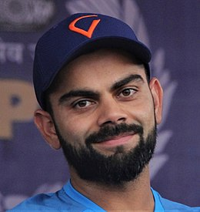
● Who can be a brand ambassador, and why?
Demographic Alignment: Virat Kohli is a prominent Indian cricketer and has a wide fan base, including both males and females. With a significant following in the target age group of 15-30, his association with the brand could help establish a strong connection with the desired audience.
Positive Perception of Energy Drinks: As per the data, a substantial percentage of the target audience perceives energy drinks as effective and healthy. If Virat Kohli shares a similar perception or can align his messaging with the positive aspects of energy drinks, it can further reinforce the brand's image and resonate with consumers.
Credibility and Influence: Virat Kohli is recognized as a successful and influential sports personality, known for his dedication, fitness, and high-performance levels. His association with the brand can lend credibility and inspire consumers to adopt a healthy and active lifestyle, which aligns with the messaging of energy drinks.
VIRAT KOHLI

Slide 26


● Who should be our target audience, and why?
Age Group: The age group of 15-30 appears to have a higher preference for online ads as a marketing channel, indicating a digital-savvy and connected audience. They also perceive the drink as effective and healthy to a greater extent. This age group could be a potential target audience due to their receptiveness to online marketing and positive perception of the product.
Gender: Males have a higher percentage perceiving energy drinks as effective and healthy compared to females. This insight suggests that males may be a target audience for your brand, as they have a more positive perception of the product.
YOUTH – MALE – TIER-1 CITY

Slide 27
CONCLUSION
Addressing brand reputation.
Exploring packaging innovation Enhancing taste.
Considering market leader pricing are key recommendations to improve brand perception, attract consumers, and gain market share.
Targeting the 15-30 age group and leveraging the preference of males for energy drinks.

Slide 28
RECOMENDATION
Implement targeted online advertising campaigns, offer limited edition packaging promotions, tailor marketing efforts for sports and exercise promotions, and explore collaborations with influential personalities like Virat Kohli to enhance brand credibility and connect with the desired target audience effectively.

Slide 29
THANK YOU

